Slide 1
Python Fundamentals-1

Slide 2
Learning objectives
Installing Python
Fundamentals of Python
Data Visualisation

Slide 3
Python Installation Process
Installation Process –
https://www.anaconda.com/products/individual
Step 1: Type https://www.anaconda.com/products/individual
at the address bar of web browser.
Step 2: Click on download button
Step 3: Download python 3.8 version for windows OS
Step 4: Double click on file to run the application
Step 5: Follow the instructions until completion of installation process

Slide 4
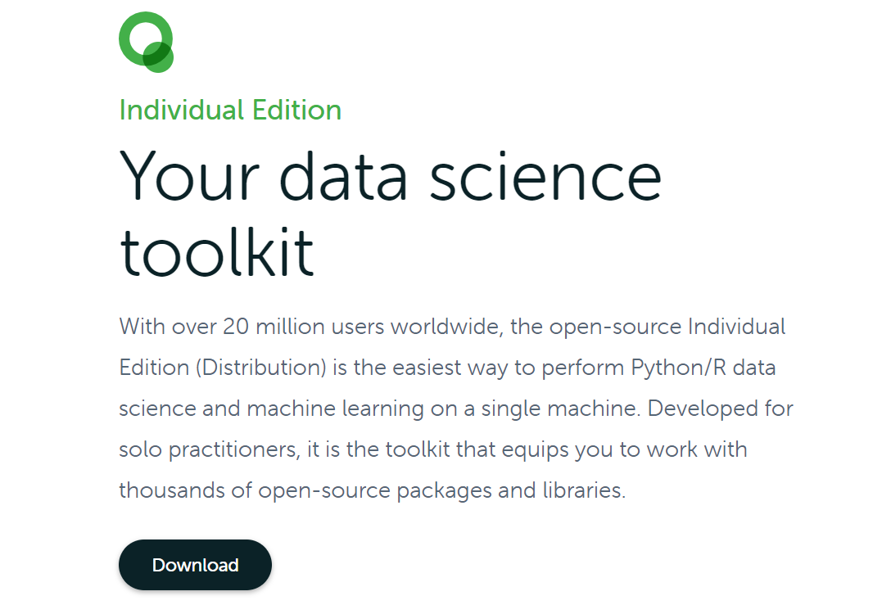
Python Installation Process

Slide 5
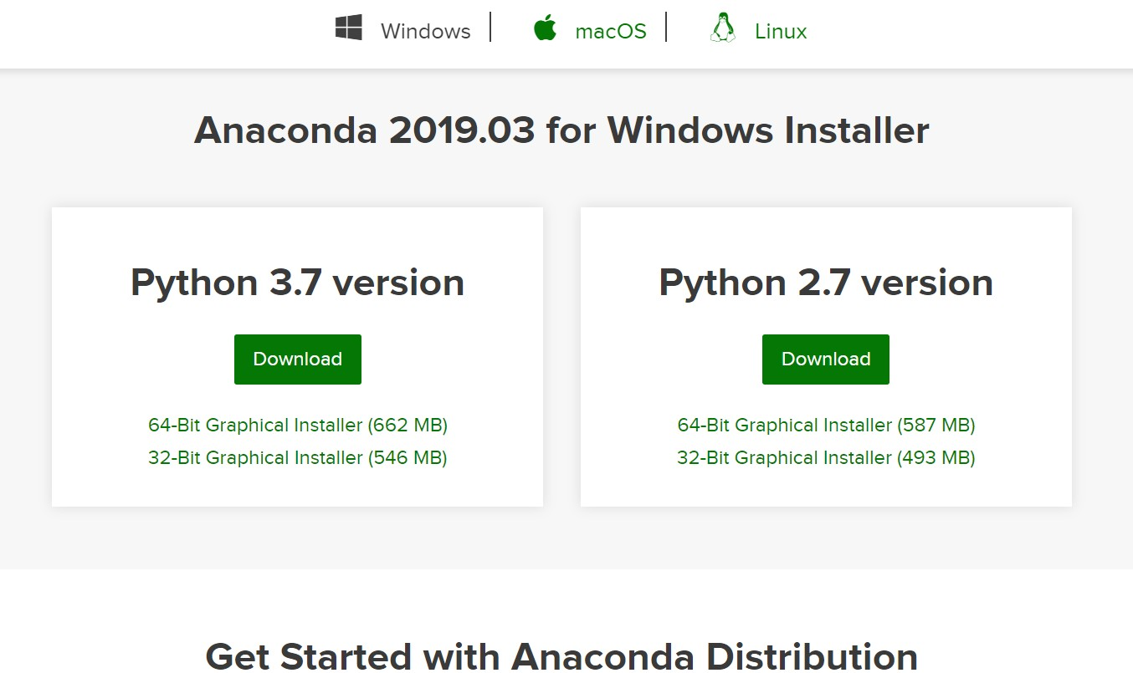
Python Installation Process
Step 3: Download python 3.7 version for windows OS

Slide 6

Python Installation Process
Step 4: Double click on file to run the application

Slide 7
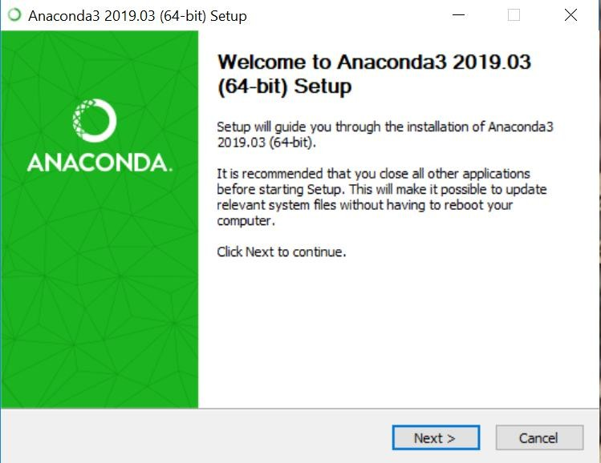
Python Installation Process

Slide 8
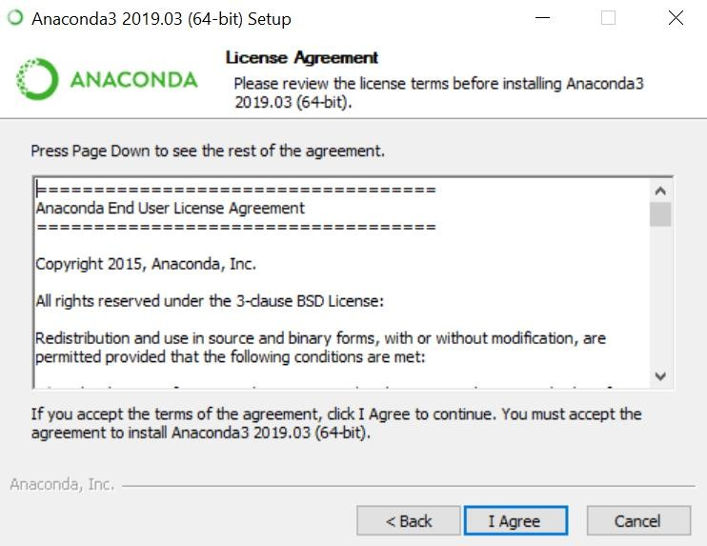
Python Installation Process

Slide 9
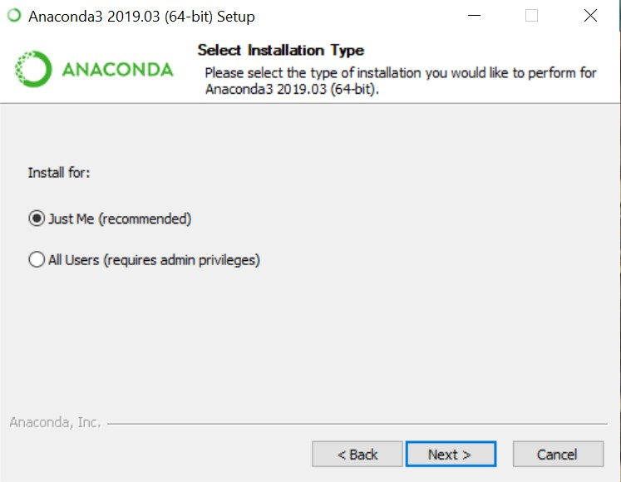
Python Installation Process

Slide 10
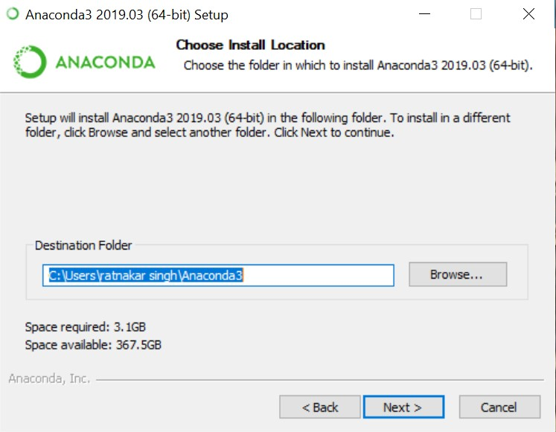
Python Installation Process

Slide 11
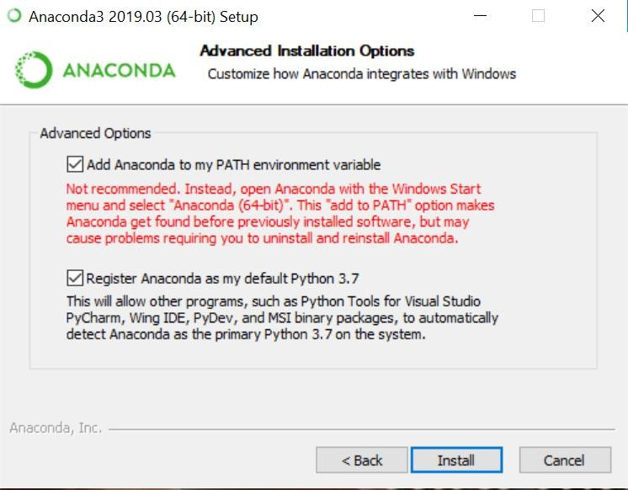
Python Installation Process

Slide 12
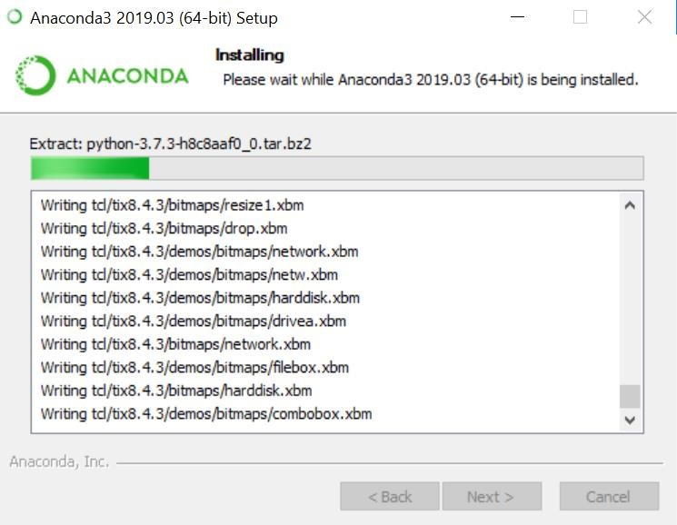
Python Installation Process

Slide 13
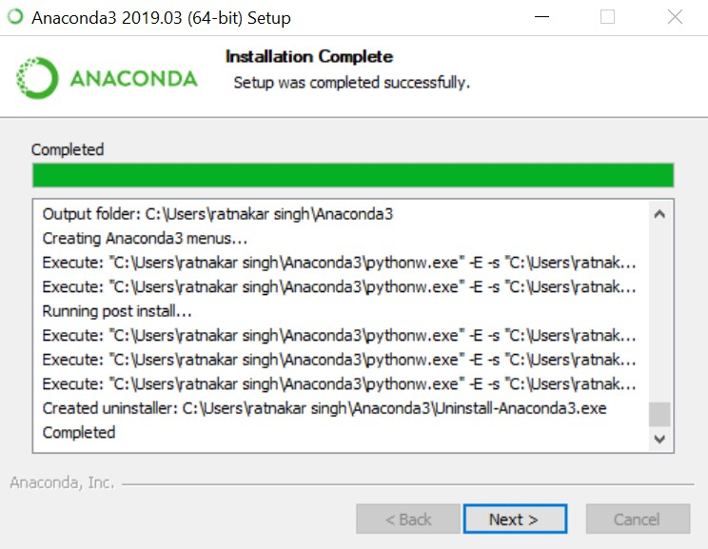
Python Installation Process

Slide 14
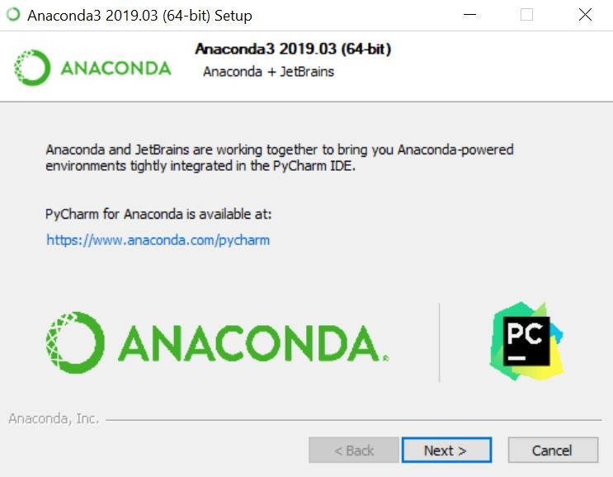
Python Installation Process

Slide 15
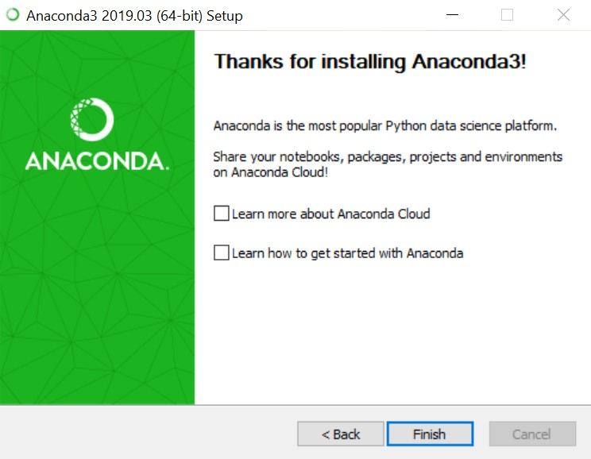
Python Installation Process

Slide 16



Why Jupyter NoteBook?
Why?
Edit code on web browser
Easy in documentation
Easy in demonstration
User- friendly Interface

Slide 17


Python and Jupyter
Python Programming Language
Jupyter Application
Software Package contains both
python and jupyter application

Slide 18
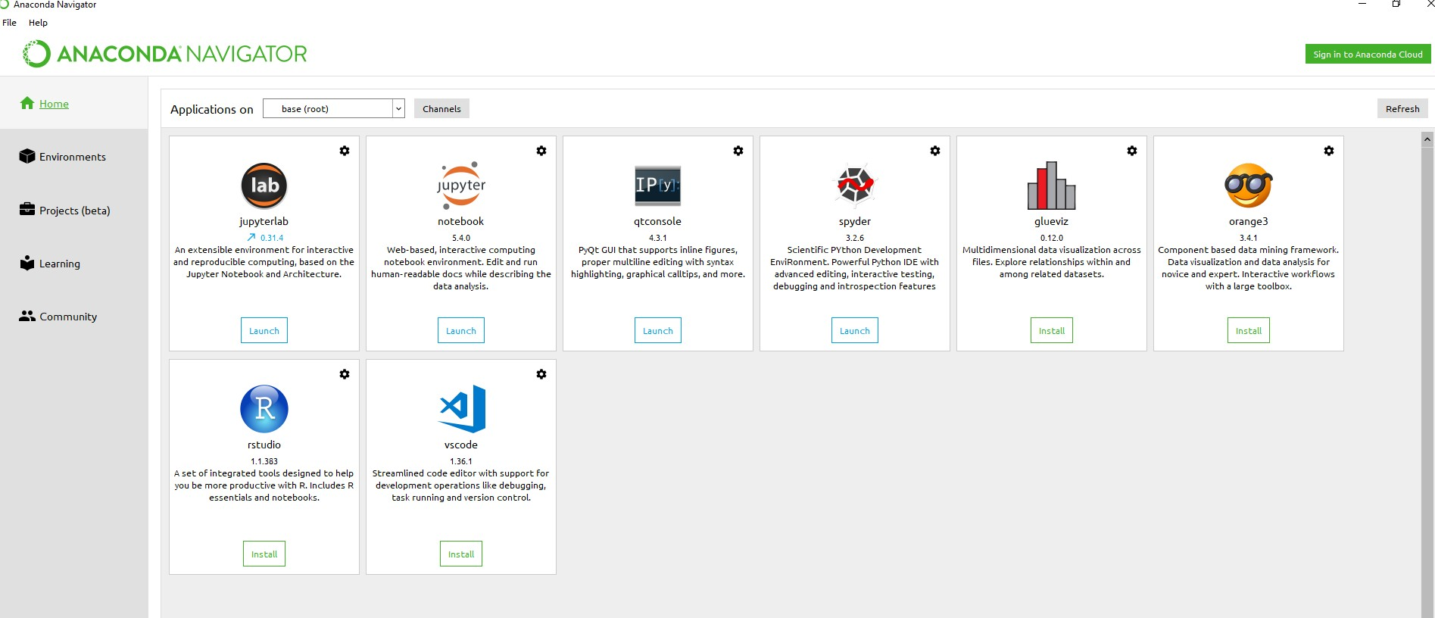

Slide 19
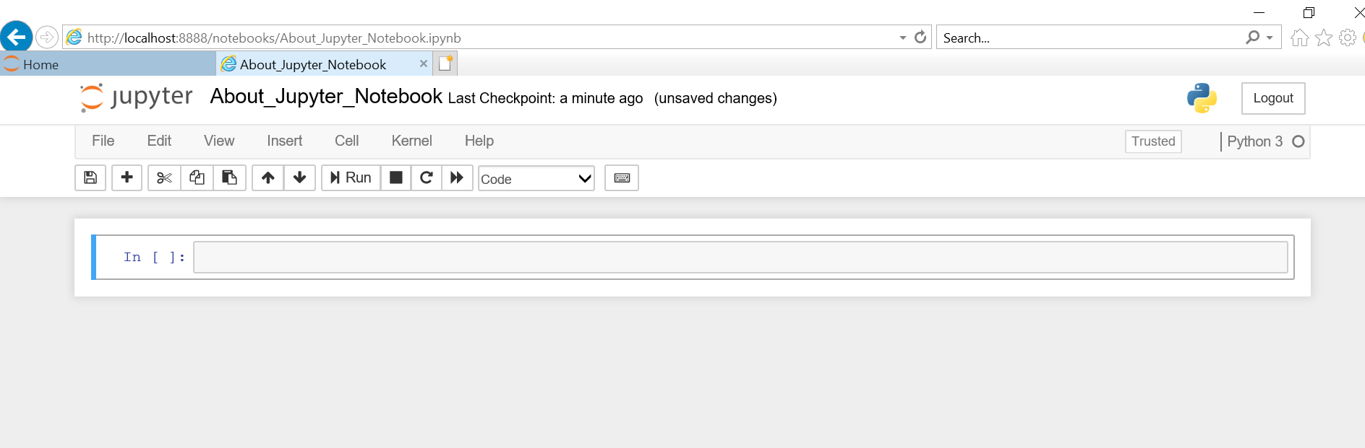
About Jupyter NoteBook
Cell -> Access using Enter Key

Slide 20
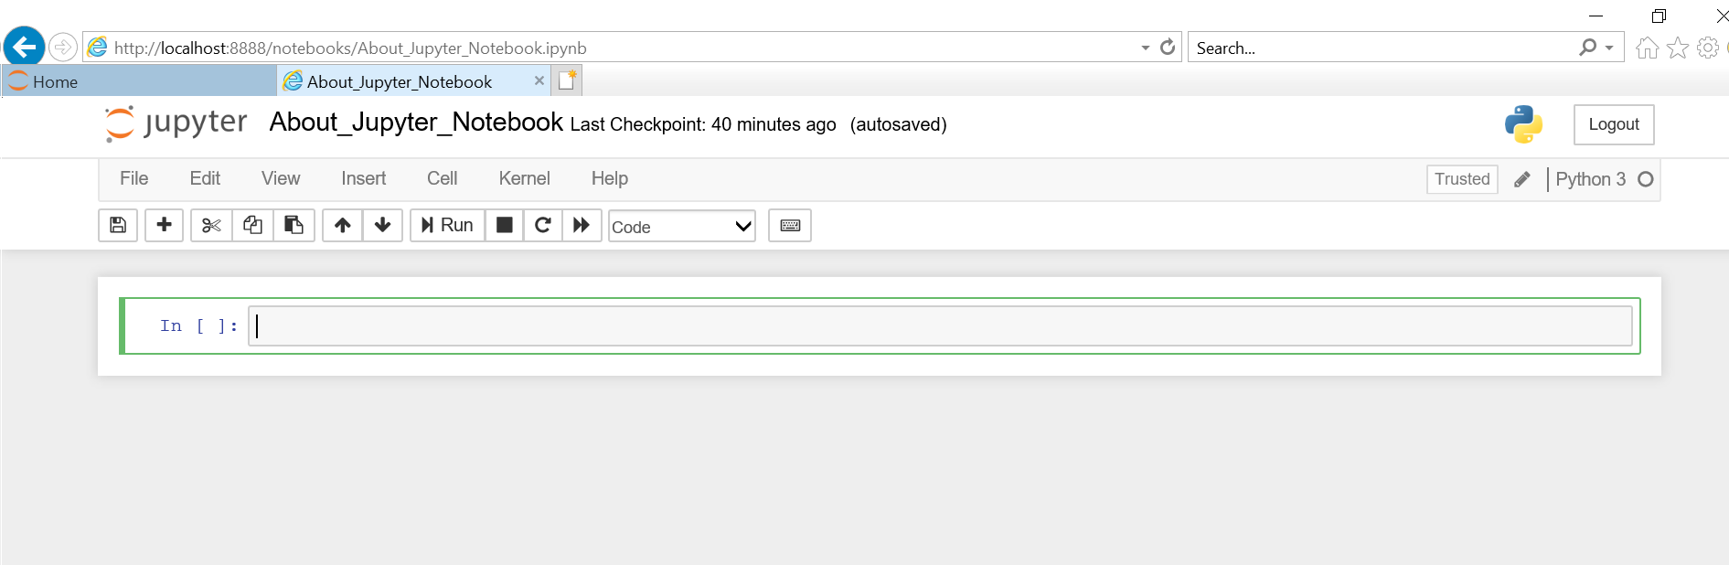
About Jupyter NoteBook
Input Field -> Green color indicates edit mode

Slide 21
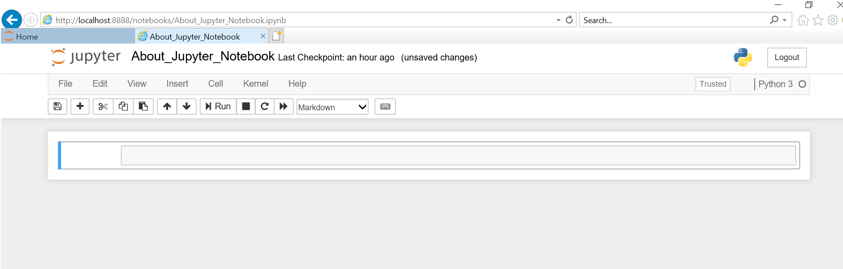
About Jupyter NoteBook
-> It contains documentation
-> Text not executed as code

Slide 22
About Jupyter Notebook
Command mode allow to edit notebook as whole
To close edit mode (Press Escape key)
Execution (Three ways)
Ctrl +Enter (Output field can not be modified)
Shift +Enter (Output field is modified)
Run button on Jupyter interface
Comment line is written preceding with # symbol.

Slide 23
About Jupyter Notebook
Important shortcut keys
A -> To create cell above
B -> To create cell below
D + D -> For deleting cell
M -> For markdown cell

Slide 24
Fundamentals of Python
Loading a simple delimited data file
Counting how many rows and columns were loaded
Determining which type of data was loaded
Looking at different parts of the data by subsetting rows and columns

Slide 25
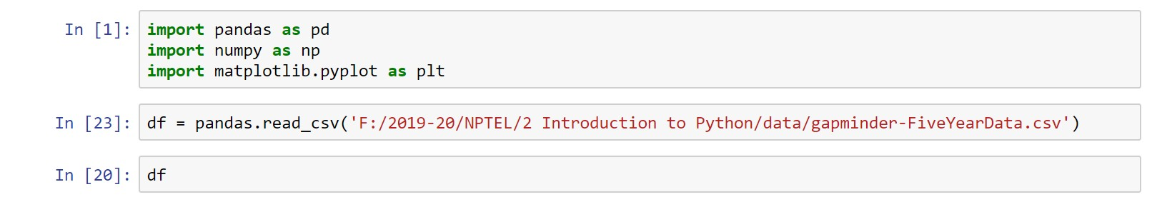
Loading a simple delimited data file
df = pd.read_csv('C:/Users/kriti/Desktop/machine Learning/experiments/gapminder-FiveYearData.csv')
Data Source: www.github.com/jennybc/gapminder.

Slide 26
What is Python Pandas?
Pandas is used for data manipulation, analysis and cleaning. Python pandas is well suited for different kinds of data, such as:
Tabular data with heterogeneously-typed columns
Ordered and unordered time series data
Arbitrary matrix data with row & column labels
Unlabelled data
Any other form of observational or statistical data sets

Slide 27
What are NumPy Arrays?
NumPy is a Python package that stands for ‘Numerical Python’. It is the core library for scientific computing, which contains a powerful n-dimensional array object.
matplotlib.pyplot is a plotting library used for 2D graphics in python programming language. It can be used in python scripts, shell, web application servers and other graphical user interface toolkits.

Slide 28
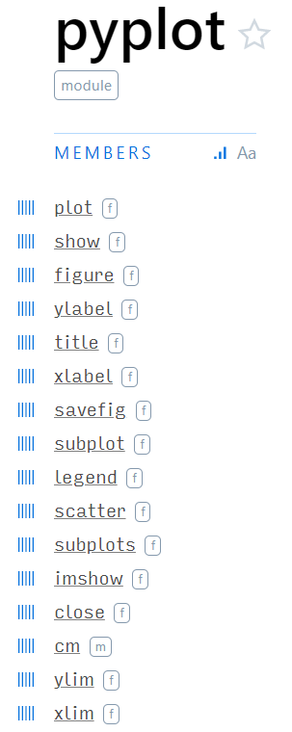

Slide 29
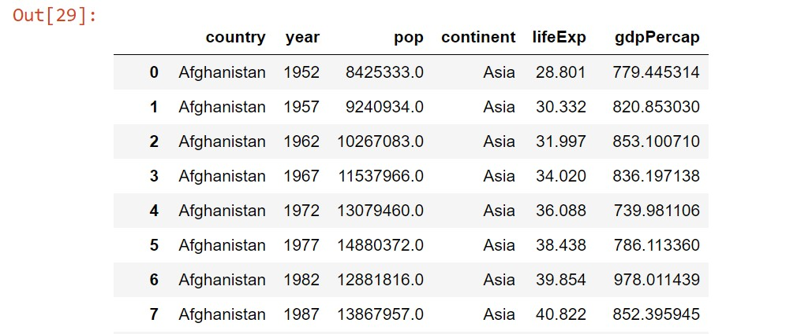

Slide 30
To see all the records
pd.set_option('display.max_rows', 1704)
df = pd.read_csv('C:/Users/kriti/OneDrive/Desktop/machine Learning/experiments/gapminder-FiveYearData.csv’)
print(df)

Slide 31
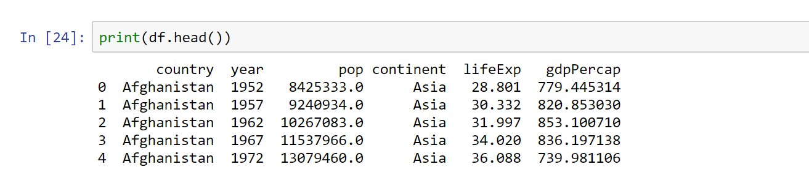
head method shows us only the first 5 rows

Slide 32
Question
1) Retrieve first 10 records

Slide 33
Get the number of rows and columns

Slide 34
get column names

Slide 35
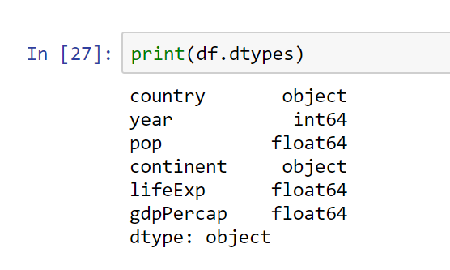
get the dtype of each column
Notes:
64 bit integer

Slide 36
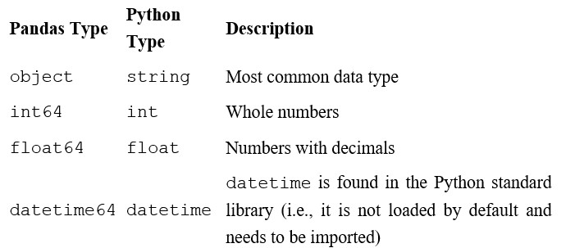
Pandas Types Versus Python Types

Slide 37
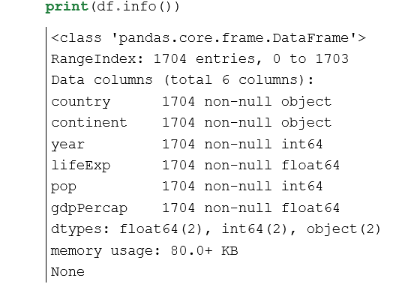
get more information about data

Slide 38
Looking at Columns, Rows, and Cells
# get the country column and save it to its own variable

Slide 39
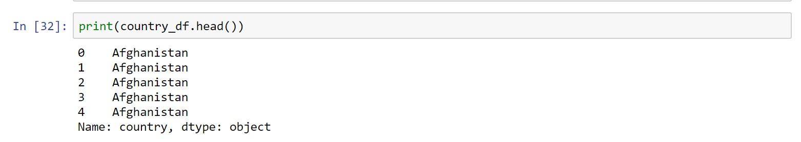
# show the first 5 observations in country column

Slide 40
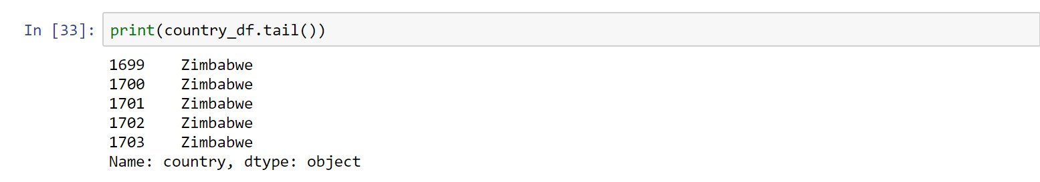
# show the last 5 observations

Slide 41
# show the last 10 observations

Slide 42
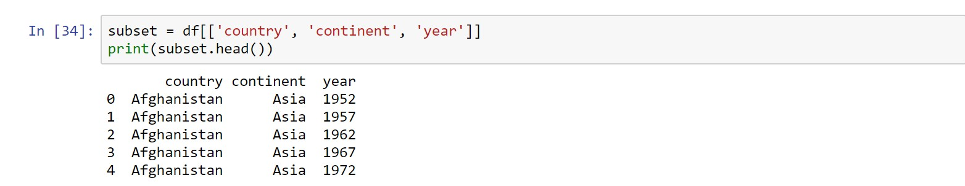
# Looking at country, continent, and year

Slide 43
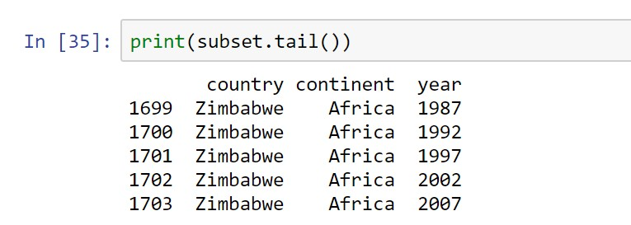

Slide 44
THANK YOU

